Slide 1

LAVA Cafe
Presented by:
Wafa albattah & Taghreed albaiz

Slide 2
About lava cafe:
From the personalities in which they exist to the communities that grow our coffee beans, we are committed to investing and creating opportunities to positively impact people's lives.
Exchanging groups, helping at work, bringing activism into work, bringing activism into individuals - all this is an axe part of our identity as a sustainable company.
As a publicly traded company, lava coffee believes in striking a balance.
between business and social amenities.

Slide 3
Tools & Libraries :
Python
Pandas
Numpy
Seaborn
Matplotlib
Jupyter notebook

Slide 4
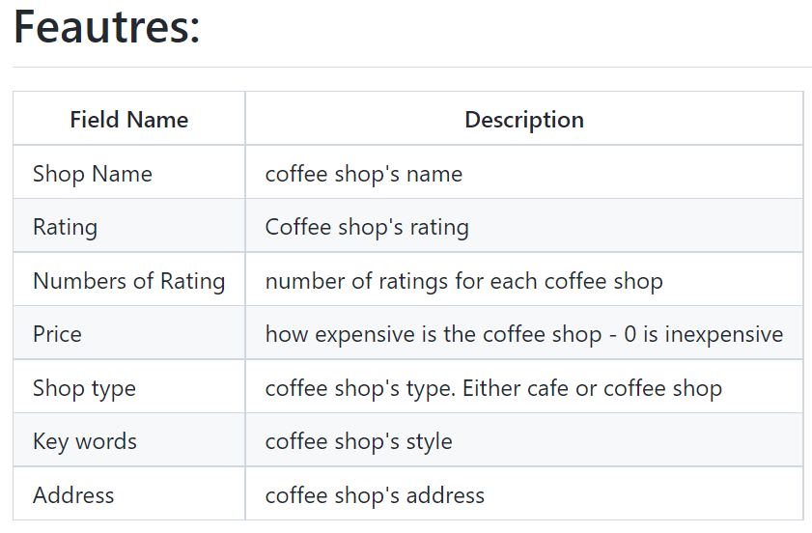
Dataset
The data was taken from the Kaggle website:
https://www.kaggle.com/mohammedhalosaimi/riyadh-coffee-shops

Slide 5
Data Cleaning
Check nulls
Fix columns
Remove columns

Slide 6
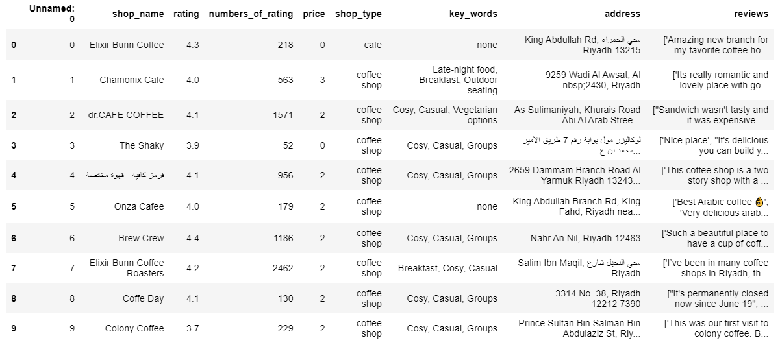
Dataframe Before Data Cleaning:

Slide 7
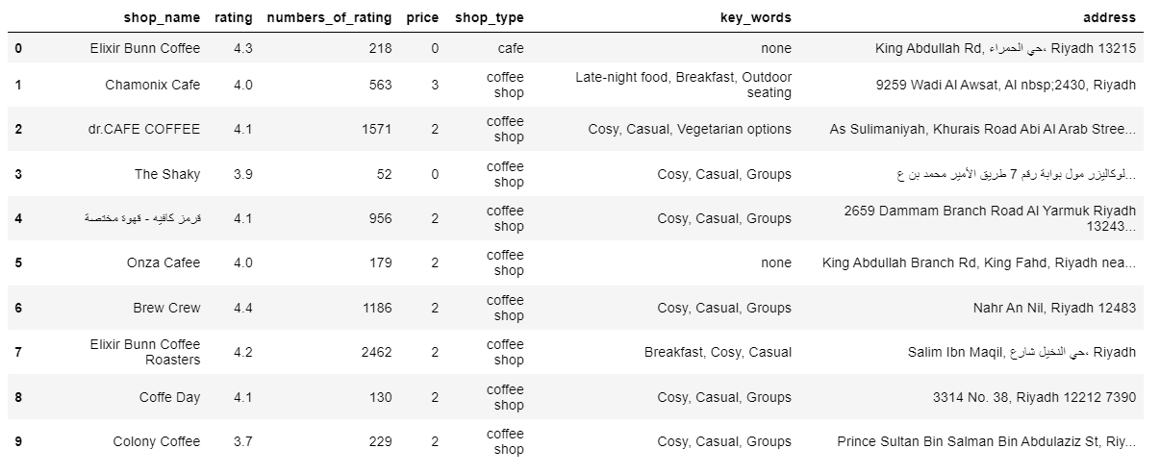
Dataframe After Data Cleaning:

Slide 8

Analysis of rating of Coffee Shops in Riyadh
The goal of the project is to analyze Riyadh cafes based on people’s ratings of most cafes in Riyadh and based on this ratings we will establish a Lava cafe.

Slide 9
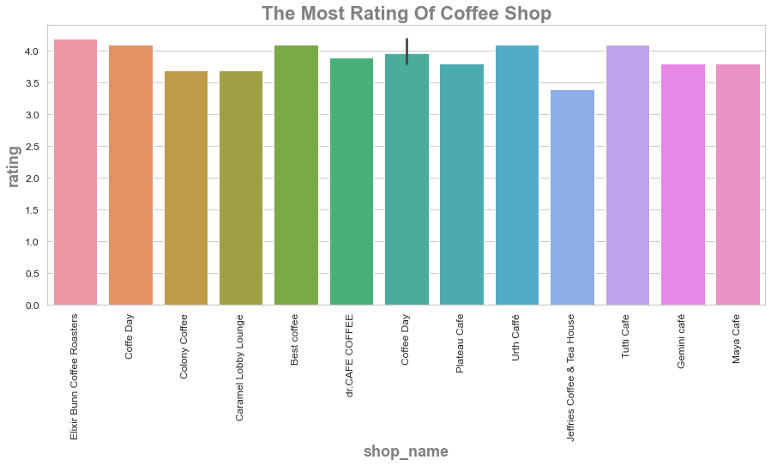
Analysis:

Slide 10
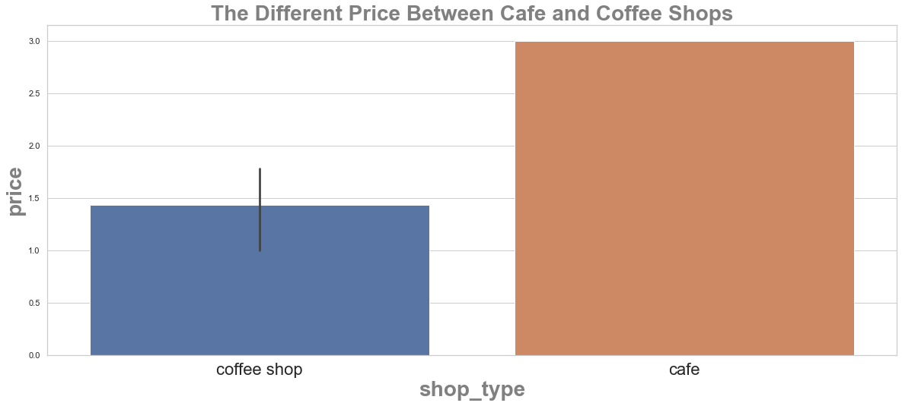
Analysis:

Slide 11
Conclusion:
In conclusion and after analysis we noticed the “Elixir Bunn coffee Roasters”
has the highest rating.
And in the shop type We noticed that cafe are more expensive than coffee shops.

Slide 12
Thank You! Do You Have Any Questions?

